Slide 1
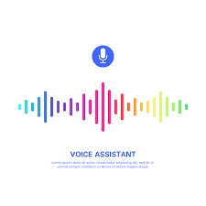
AI VOICE ASSISTANT
An improved way of communication
AMAN TARIQ (2292014)

Slide 2
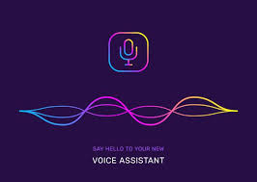





content
introduction
History
Types of voice assistant
Features
Advantages and disadvantages
Conclusion
references

Slide 3

introduction
A voice assistant is a digital assistant that uses voice recognition language processing algorithm.
Synthesis to listen specific voice commands and return relevant information or perfrom.
Perform specific functions as requested by you the user today voice assistants.
Integrated into many of the devices we use on a daily basis such as cell phones computers and smart speakers because of their wide array of integration there are different voice assistants

Slide 4

history
Apple’s Siri debuted in 2011.
At the Seattle World’s Fair in 1962, IBM presented a tool called Shoebox.
It could recognize 1,011 words, which is about the vocabulary of a three-year-old.
In the 1970s, (DARPA) — created Harpy. It could recognize 1,011 words.
1990s, companies like IBM, Apple, and others created items that used voice recognition.

Slide 5
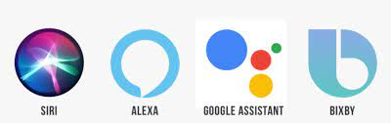
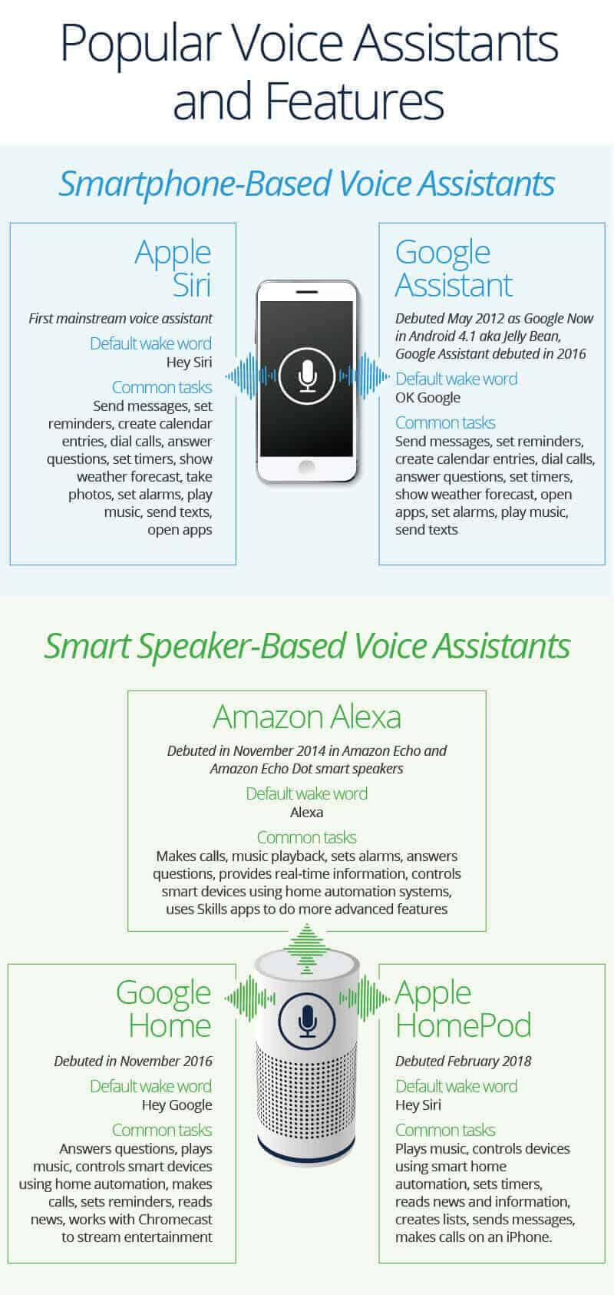
Types of assistant

Slide 6

features
CAN BE USED :
to search on google
to open youtube
to play music by providing access of music directory
Wikipedia search

Slide 7

Types of voice assistant
Google Assistant
Microsoft Crotana
AI VOICE ASSISTANT
Amazon Alexa
Siri By Apple

Slide 8
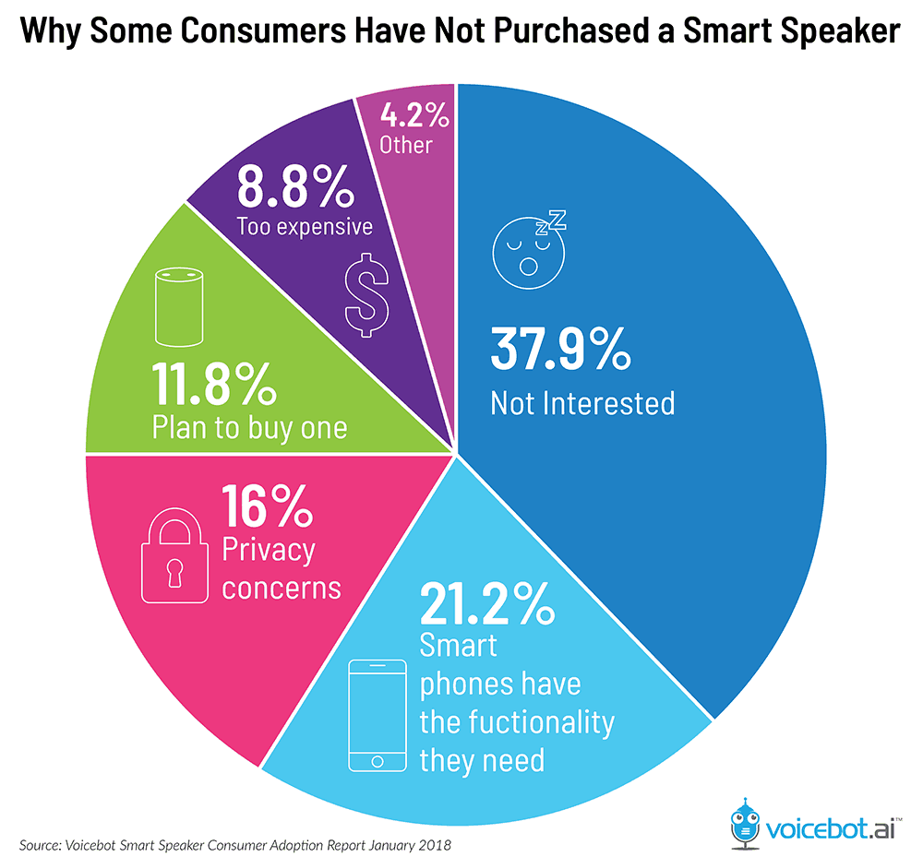
Advantages of Voice Assistants
Hands-free Functionality
Variety of Skills
More Free Time
Help With Your Distress

Slide 9
Disadvantages of Voice Assistants
Signal Strength
Voice is Essential
Lack of Accuracy and Misinterpretation
Accents and Speech Recognition
Background Noise Interference
Background Noise Interference

Slide 11

reference
https://www.geeksforgeeks.org/
https://smarthomesschool.com/advantages-and-disadvantages-of-digital-voice-assistants/#:~:text=1%20Advantages%20of%20Digital%20Voice%20Assistants.%20One%20of,enhance%20convenience%20and%20comfort%20in%20a%20smart%20home.
https://blogs.oracle.com/marketingcloud/post/advantages-and-disadvantages-of-voice-assistants-for-marketers
https://www.techwalla.com/articles/the-disadvantages-of-voice-recognition-software

Slide 12


